Slide 1
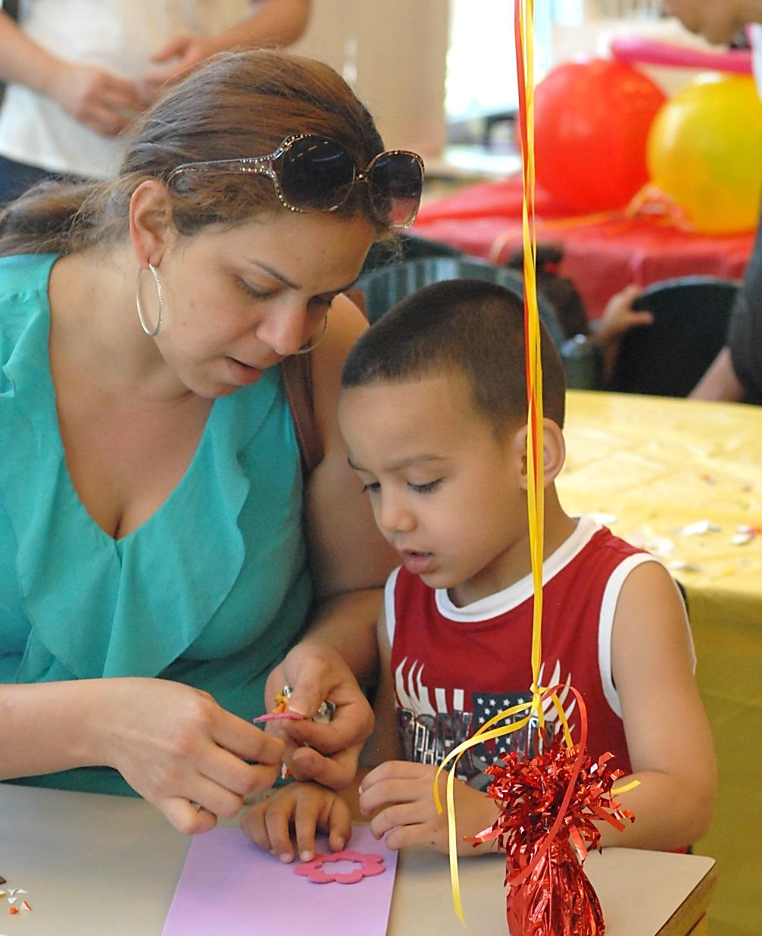

A Life Spent with Children
Careers in Early Education and Care and Out of School Time

Slide 2
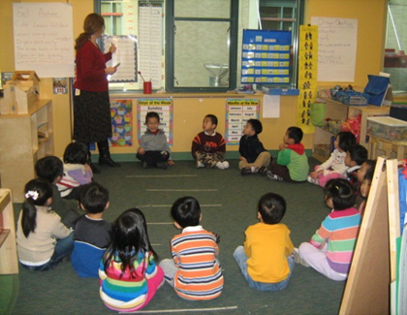
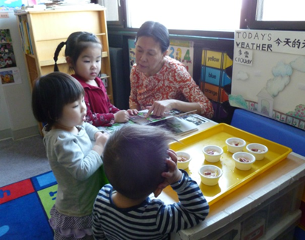
Acknowledgements
The following presentation was originally developed by Boston Chinatown Neighborhood Center, and was adapted by English for New Bostonians.

Slide 3
Important Vocabulary
Early education
Out of school time
Caregiver
Certificate
Degree (AA. BA. M.A.)
Higher Education
Module
Orientation
Success

Slide 4
Important Adjectives
Creative
Energetic
Playful
Successful
Friendly
Meaningful

Slide 5
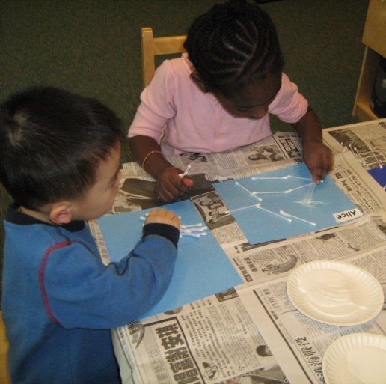
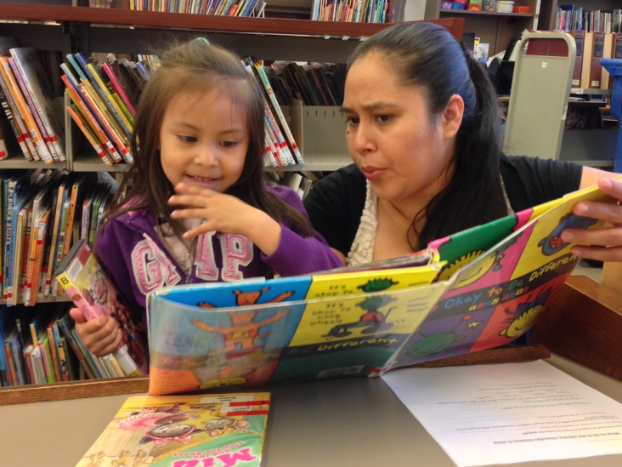
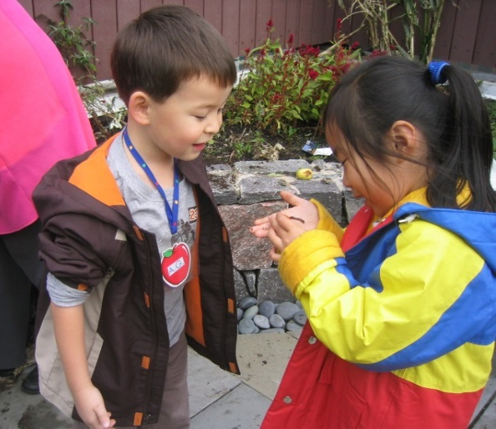
Are you…
…fascinated with how children grow and develop?

Slide 6
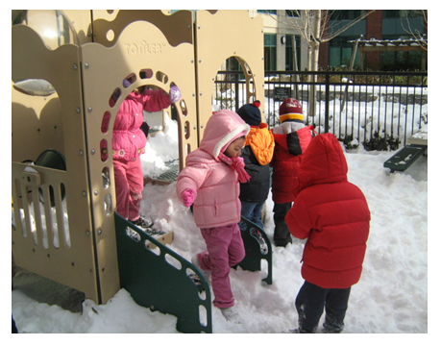
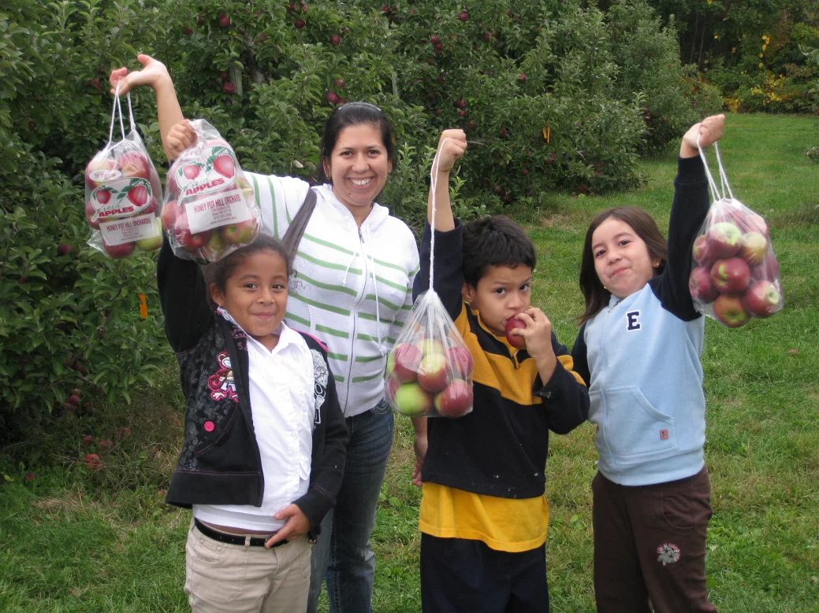
…creative, energetic and playful?

Slide 7
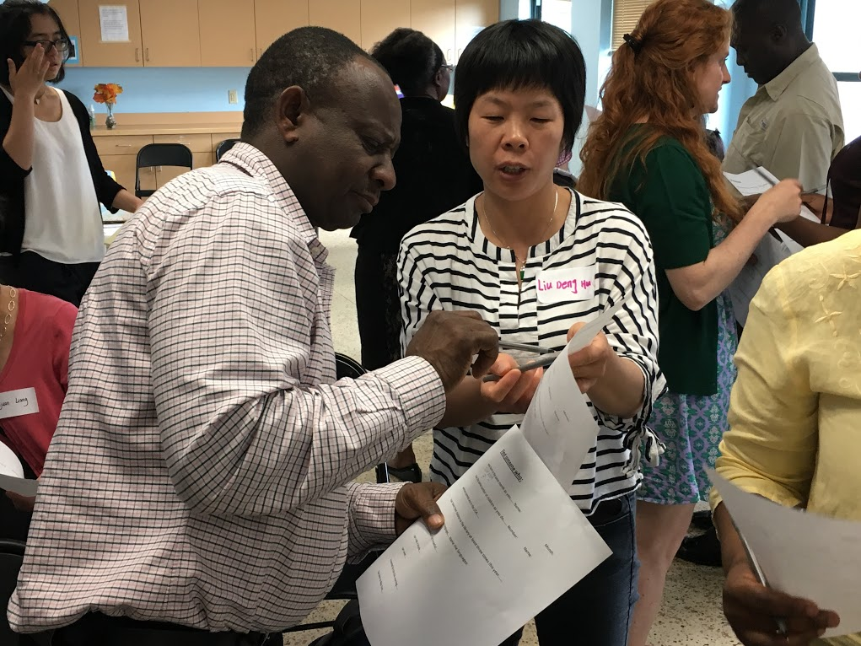
…someone who loves to learn new things?

Slide 8
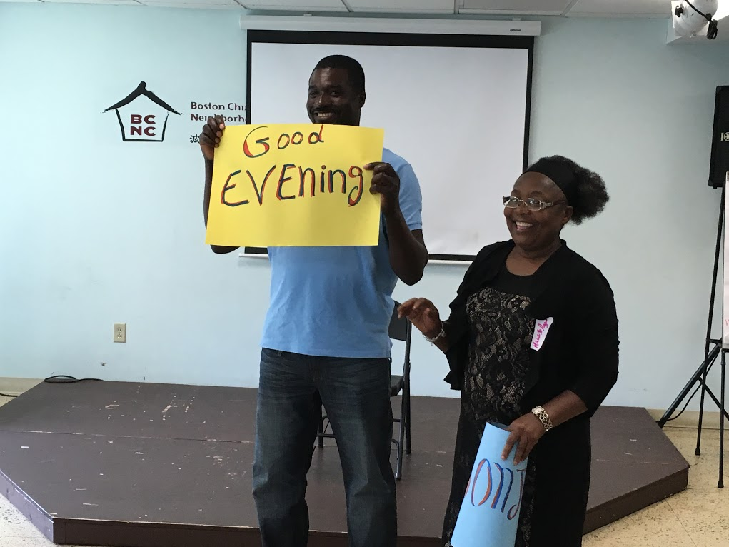
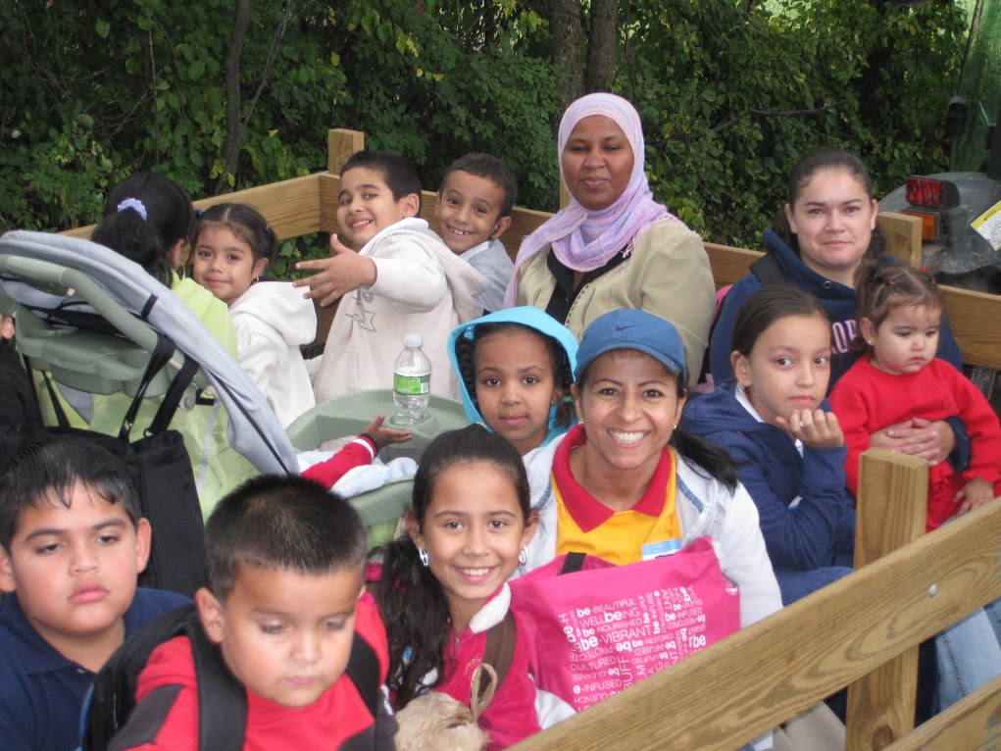
…a people person?

Slide 9
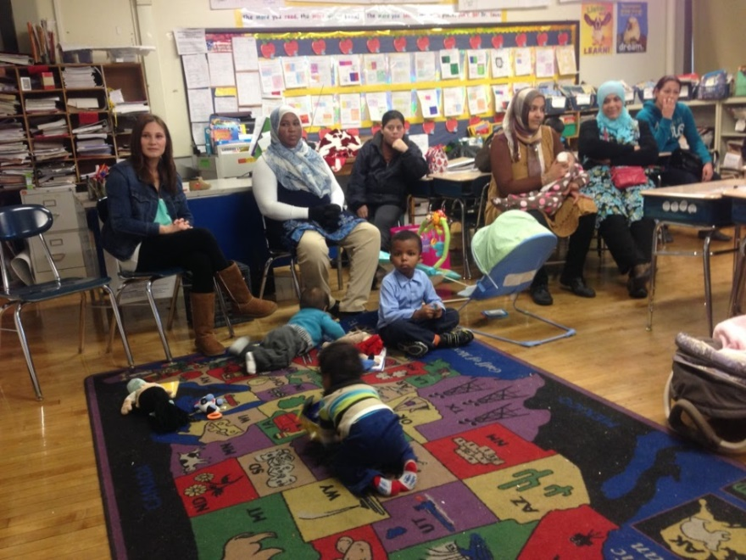
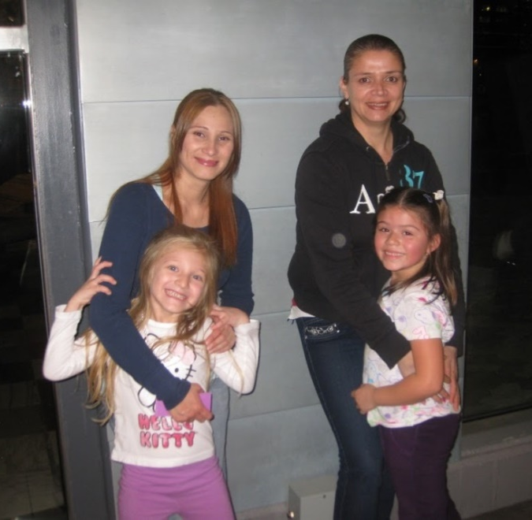
Then you might enjoy working in early education or out of school time.

Slide 10
What are the jobs in the field?
There are many opportunities in many settings.
Family child care
Center based care
Head start
Elementary schools
Out of school programs

Slide 11
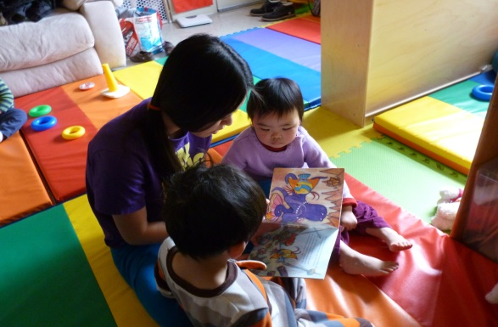
What is family child care?
Family child care is care and education that happens in a home setting.

Slide 12
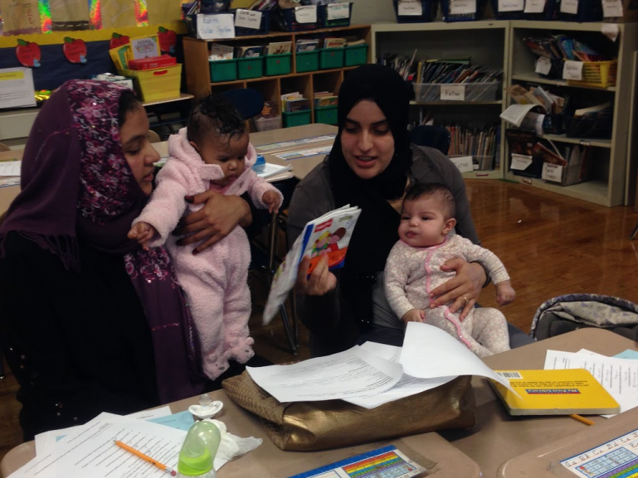
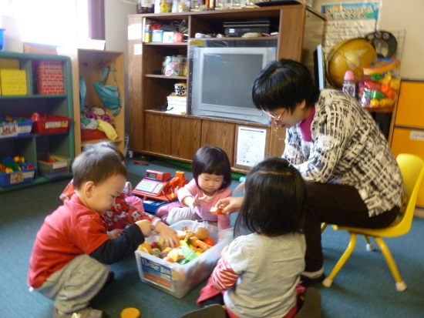
What does it take to become a family child care educator?
You must have some experience caring for children.

Slide 13
You must participate in regular trainings
A pre-orientation where you will explore basic licensing requirements and see if this field is for you
A five hour module before you receive your licensing with ideas about space, curriculum, and beginning your home child care
A five hour module six months after you are in business that supports you to build a developmentally rich curriculum

Slide 14

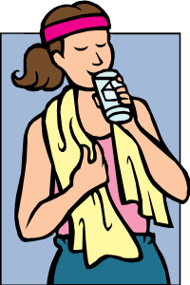
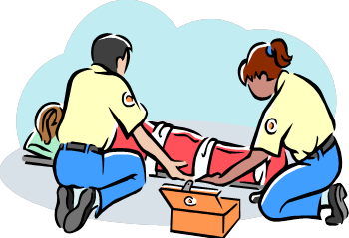
What else?
You must prove that you have no criminal or abuse record and there is no one who lives with you that has such a record.
You must be healthy and fit to care for children.
You must learn first aid and CPR.
You must participate in regular training to learn about children, curriculum, families, and running a successful family child care business.

Slide 15

What does it take to be successful?
You need to be a smart business person because family child care is a business and you want to make a decent living.

Slide 16
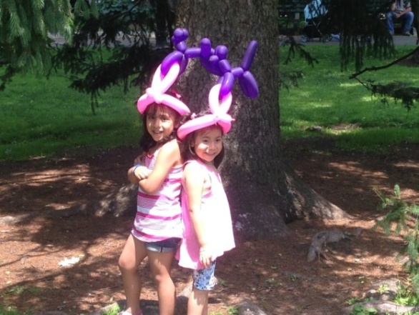
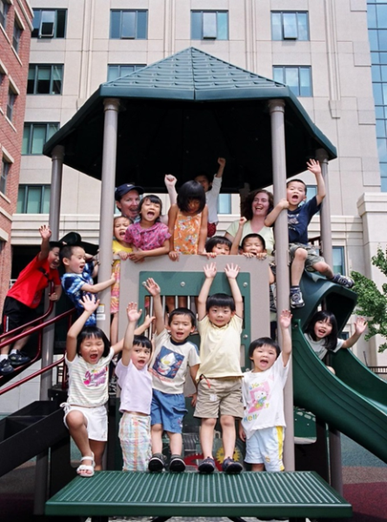
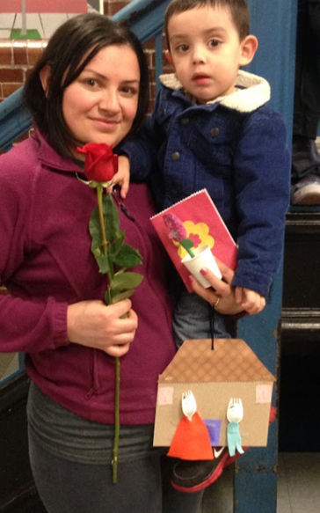
What else?
You must be energetic to care for children all day.
It is important to be a person that people trust and like. Be friendly and caring.

Slide 17
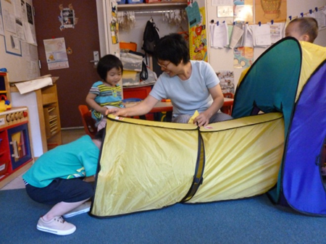
It is necessary to have…
A home or apartment that is safe for children with enough room and permission from your landlord or condo association and/or family to become a licensed home.

Slide 18
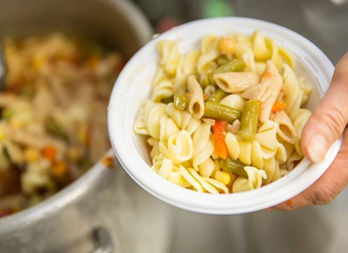
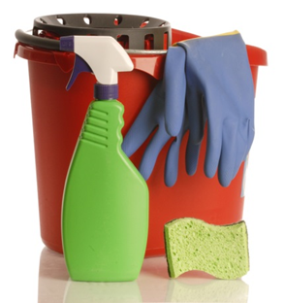
You need to be able to:
cook
keep a clean and healthy home
plan fun learning activities
keep children’s records
maintain a good relationship with parents
run a profitable business

Slide 19
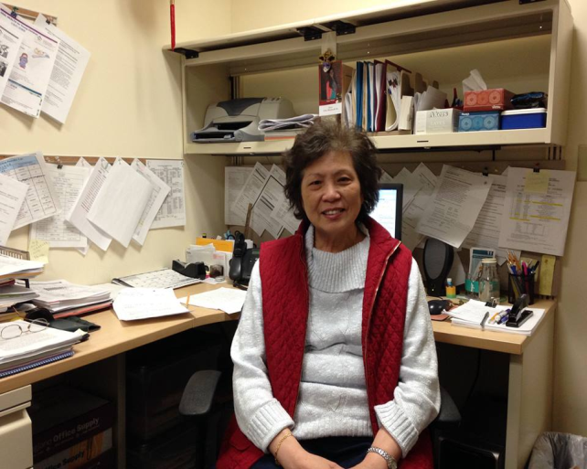
Other roles in family child care
You can be a home visitor and help support the licensing of family child care. You will coach and mentor home care educators and plan training and resources to support them and the children they care for in their home.

Slide 20
What will I need to be a home visitor?
An early childhood degree (AA or BA)
Experience working with children and families
Desire to support and work with family child care educators

Slide 21
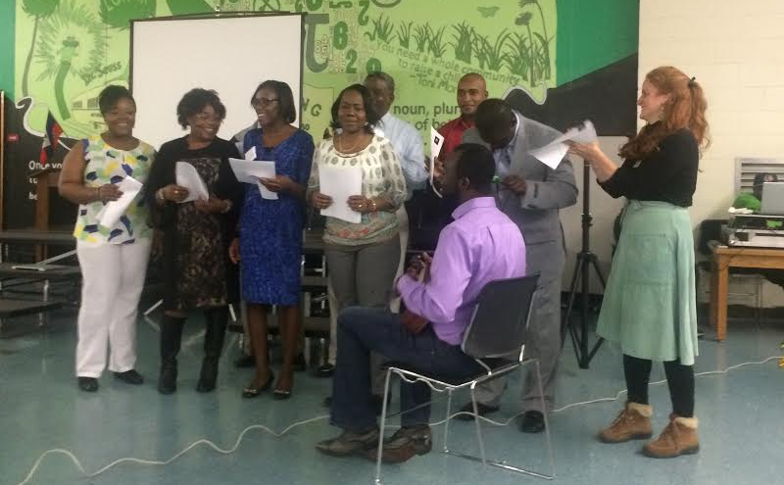
Where can I learn more?
Your local Child Care Resource and Referral Agency can provide basic information about the licensing process. In Boston, this agency is Child Care Choices. WWW.childcarechoicesofboston.org
The Early Education and Care (EEC) website also has information on licensing. In Boston, the local CCR&R is Child Care Choices. WWW.childcarechoicesofboston.org

Slide 22
Can I get early childhood training in other languages?
Urban College in Boston offers child development classes in Chinese, Spanish, and English. They also will help you with to enroll and to apply for financial aid.
Many community colleges, like Bunker Hill, offer early childhood education courses, but only in English.

Slide 23
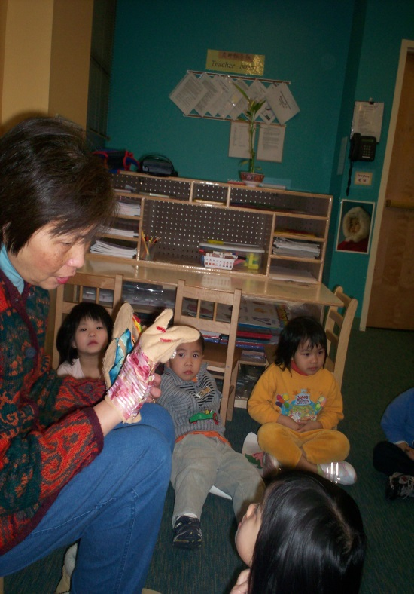
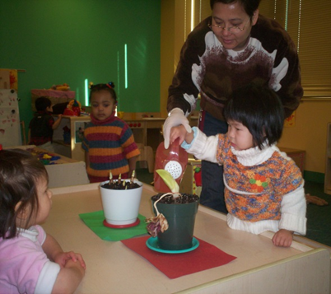
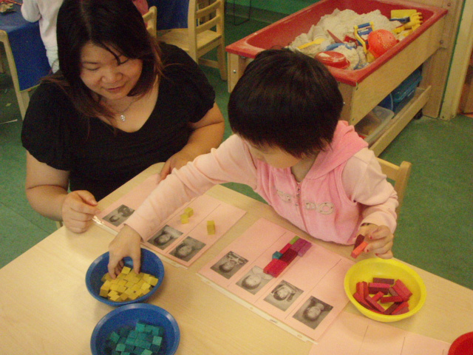
What do you need to work in a child care center?
Dependability

Slide 24
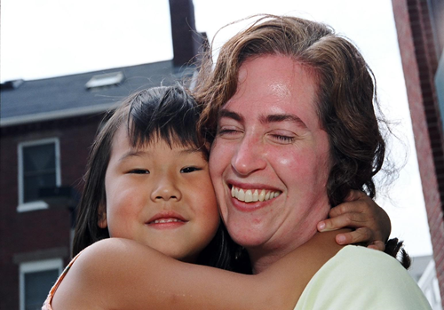
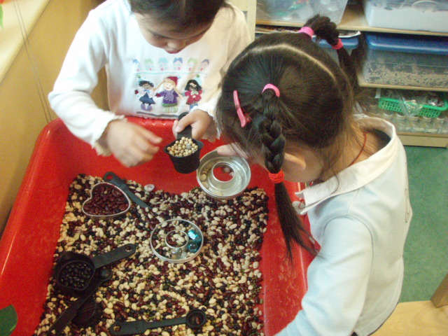
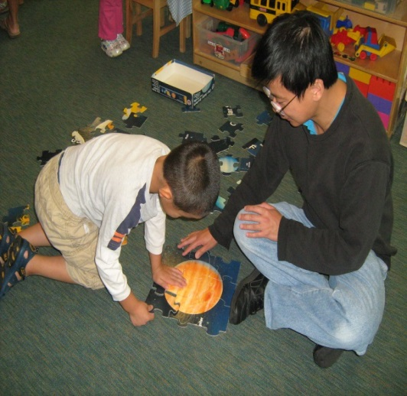
Interest in young children and how they grow

Slide 25
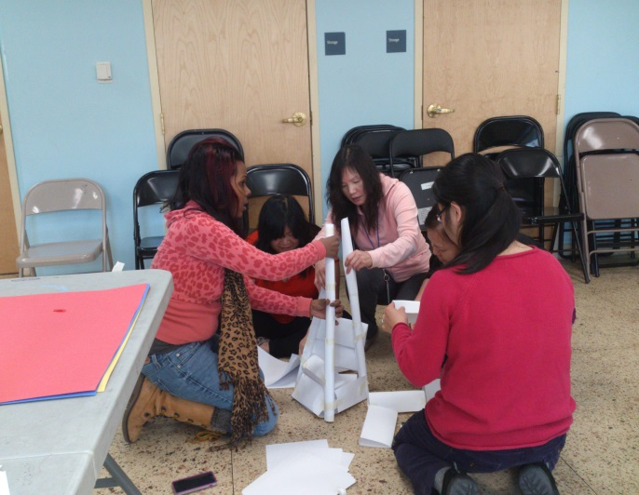
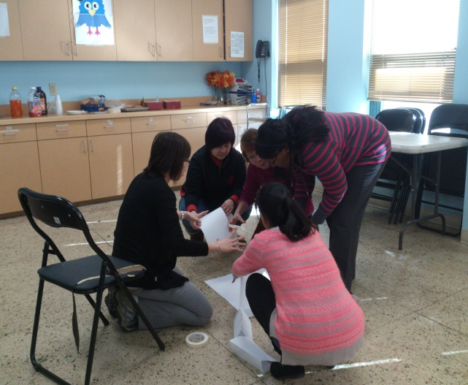
Ability to work in a team

Slide 26
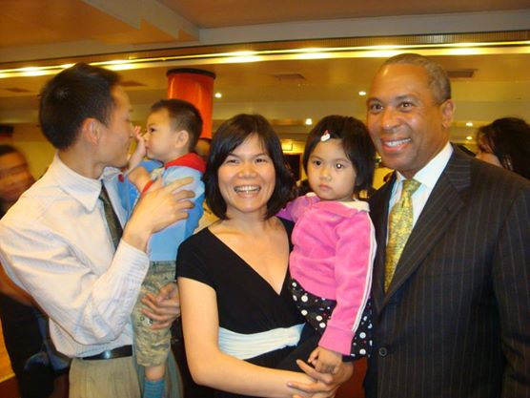
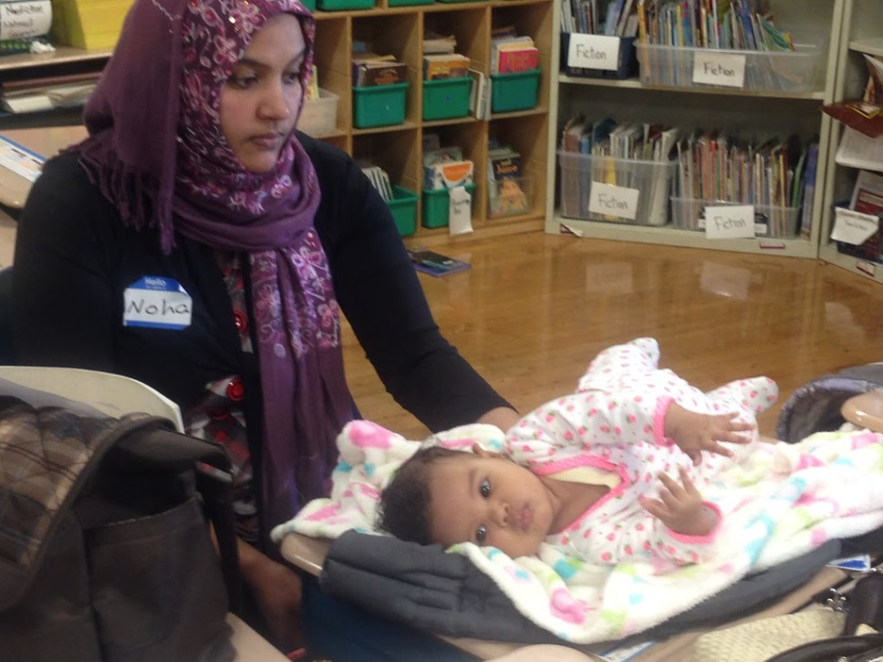
A liking for young families

Slide 27
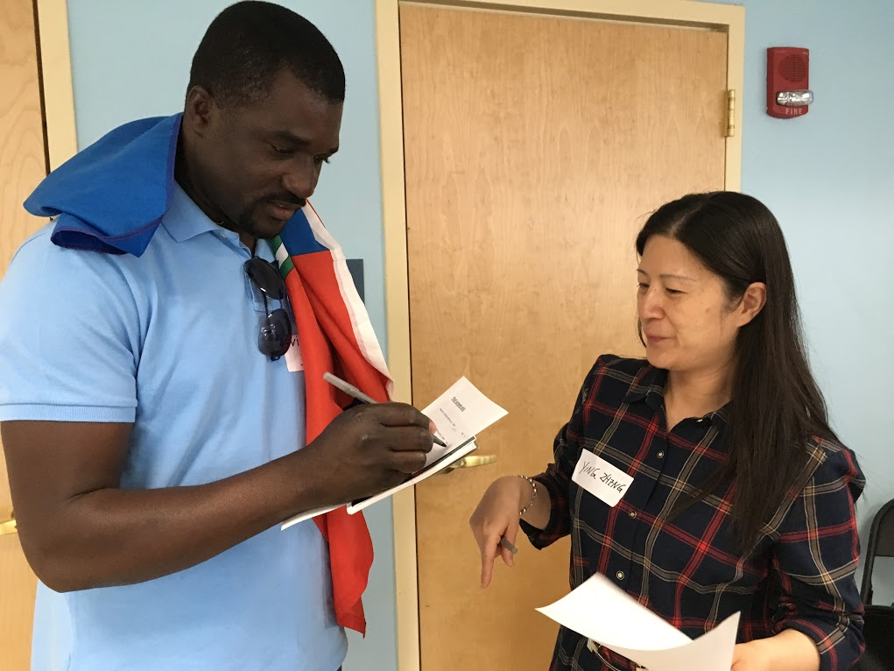
Good communication skills

Slide 28
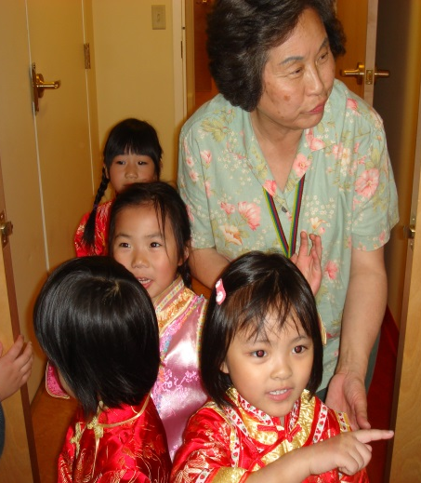
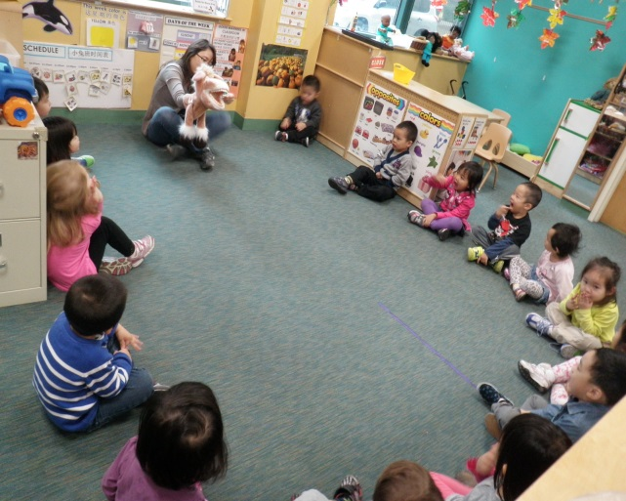
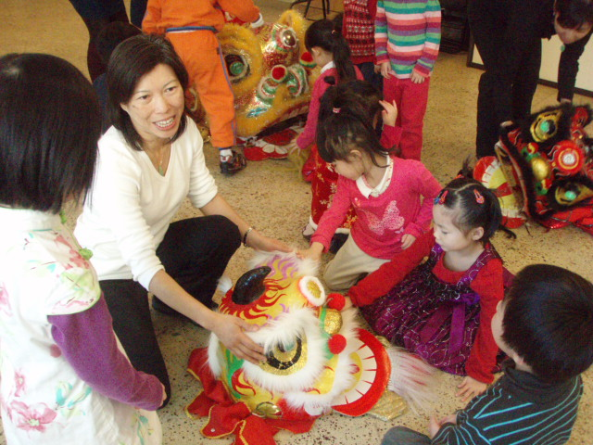
Creativity and playfulness

Slide 29
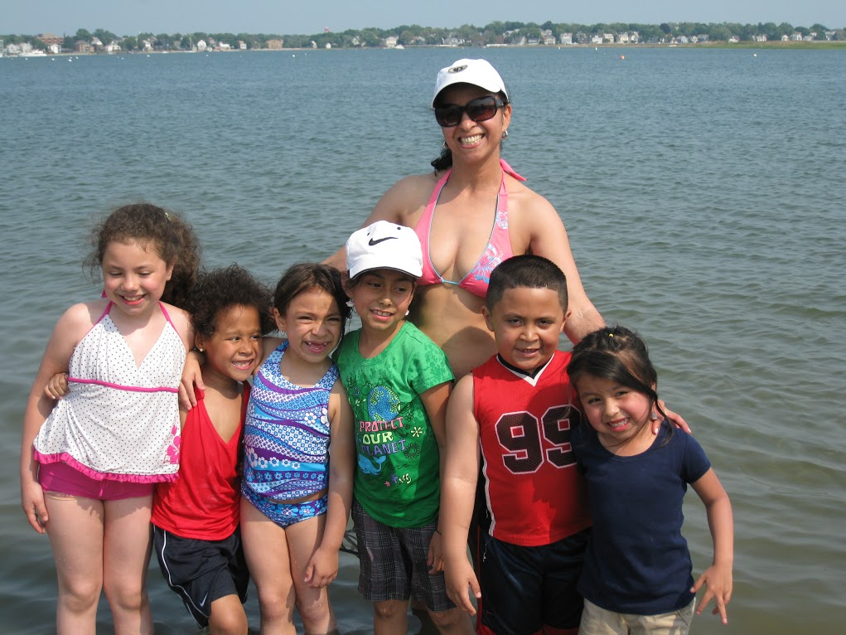
Energy and good health

Slide 30
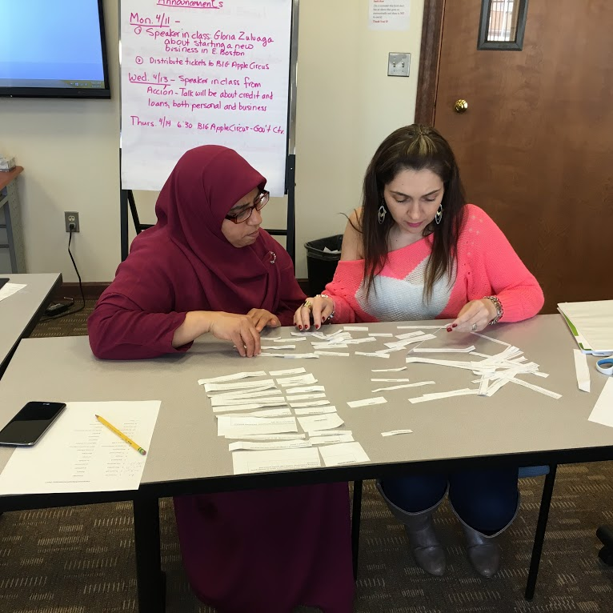
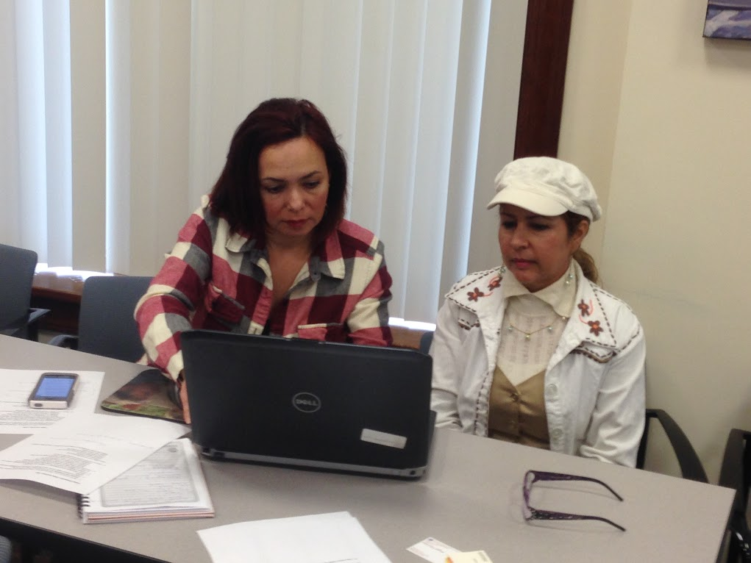
A love of learning

Slide 31
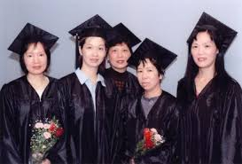

What if I want to work in a licensed child care center as a teacher?
Start with a course in child development. Many colleges offer this in English. Urban College in Boston offers it in Chinese, Spanish, and English.

Slide 32
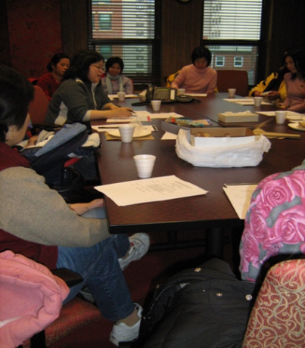
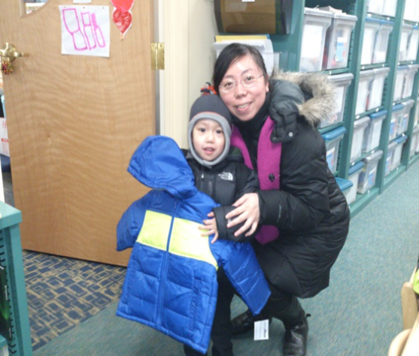
What else will I need to study and learn?
How to plan interesting and appropriate activities for children
How to work with parents and caregivers so they can help their children grow and develop

Slide 33

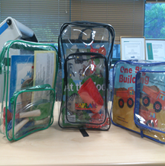
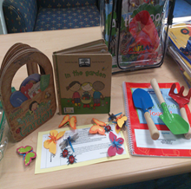
Other classes I can choose?
There are many interesting subjects such as choosing children’s books, planning for science and math experiences, and helping children to be healthy and safe.

Slide 34
Will I need a degree?
A degree always helps and in the future more and more jobs will require a degree. But now, many jobs in early childhood education only require certificates.
Some possibilities are:
--Certification as an EEC teacher
--A child care certificate
--A CDA (Child Development Associate)
Family Day Care does not require any certification. But you must attend 10 hours of training every year.

Slide 35
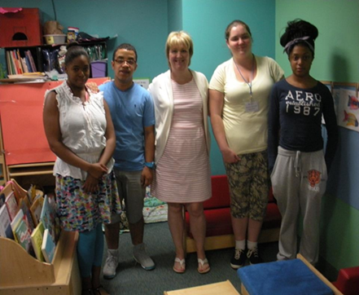
Experience
You will also want to gain some supervised experience in a child care program. You can do this in several ways.
a) Work as a substitute teacher
b) Become an intern through a college
c) Work as an assistant in a child
care program

Slide 36
What else do I need?
A criminal and sexual record check and to be finger printed to prove you are safe to be around children
A physical and proof you are healthy
A first aid training certificate

Slide 37
How do I enroll in a college?
You can get information at the Boston Public Library College Planning Center at the Copley Square main branch.
Their services are free and you can drop in without an appointment.

Slide 38

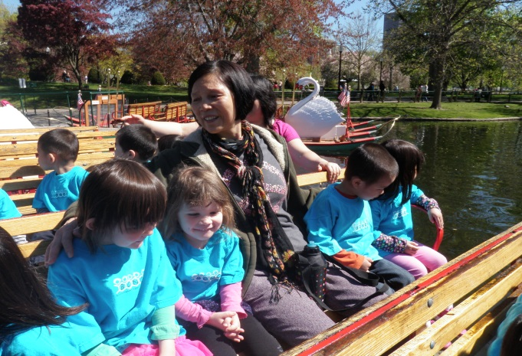
What if I’m not ready for college?
You can start with workshops and gradually begin to take college courses.
You can work as a substitute assistant teacher in a child care classroom and see if you like working with children.

Slide 39

What else can I do in a child care center?
You can be:
An administrator in a child care program
An administrative Assistant
An educational specialist
A director
An assistant director
A teacher/mentor
A center cook

Slide 40

What if I want to work in a Boston public school program as a teacher or paraprofessional?
To be a teacher, you will need to get a Master’s Degree. To be a paraprofessional, 44 credits of higher education or a AA or BA degree are required.
These can be from a university in your country.

Slide 41
What about out of school?
Out of school positions require some of the same things.
Health care check up
Criminal Record check, sexual record check, and fingerprints
3-9 months experience in a licensed out of school program (depending on education)
Training hours

Slide 42


Out of School
You will work with elementary school age children when they are out of school.
Most of the year, hours will be part time but will switch to full time in the summers and on vacations.

Slide 43


What else do I need?
Academic skills to help children with homework
Ability to develop strong relationships with children and their parents
A passion to share:
  Art
  Music
  Sports
  Children’s literature
  Dance
  Science
  Computers

Slide 44
Are there any full time jobs in out of school?
You can be an administrator, a director, or a site coordinator and be responsible for supervision, program planning, and funding an out of school program.

Slide 45
Where do I start?
There are different paths for different people
Different end careers
College
Work
FCC
Family Child Care
Home visitor
Early Childhood
Child Care Educator
Child Care Administrator
Out of School
Out of School Administrator
Out of School Group Leader

Slide 46


What if I don’t know yet?
Start with workshops
You can volunteer
Be a substitute teacher

Slide 47



Why should I choose child care?
Children are our future and your work matters.
If you like being with children you will love your work.

Slide 48

It’s becoming a recognized profession
We now know that critically important brain development takes place between the ages of 0-3. So early child education is now recognized as key to children’s success.

Slide 49

Will I make a lot of money?
Not compared to some other professions, but you will always have work and a meaningful life. It matters if you come to work and many people find they can make a living wage.

Slide 50
What else?
The best reason is because you really like being with children and seeing them grow and develop and you love working with young families. If you do, early childhood education may be the right career for you.

